Slide 1
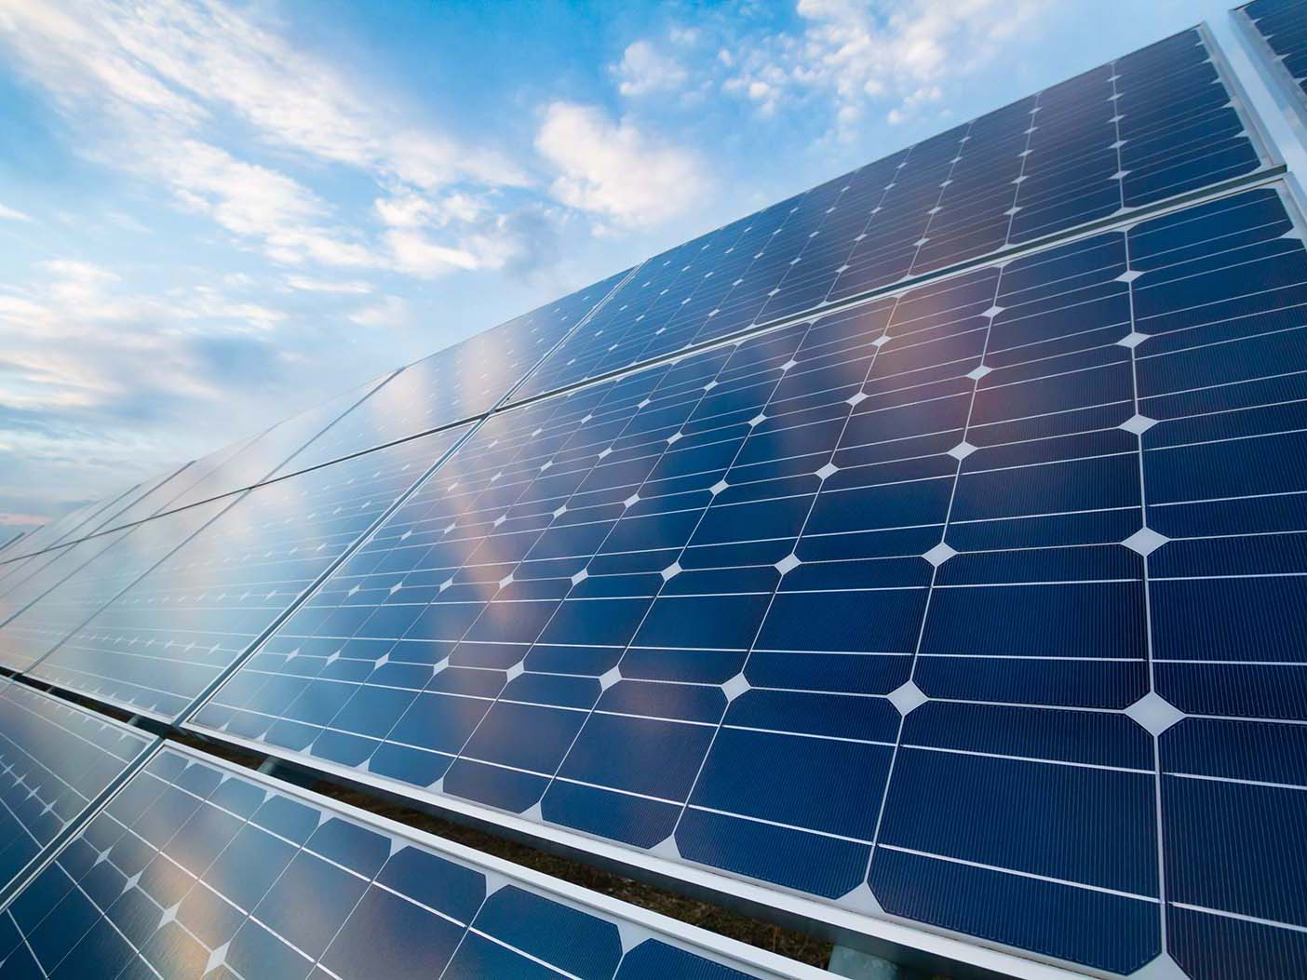





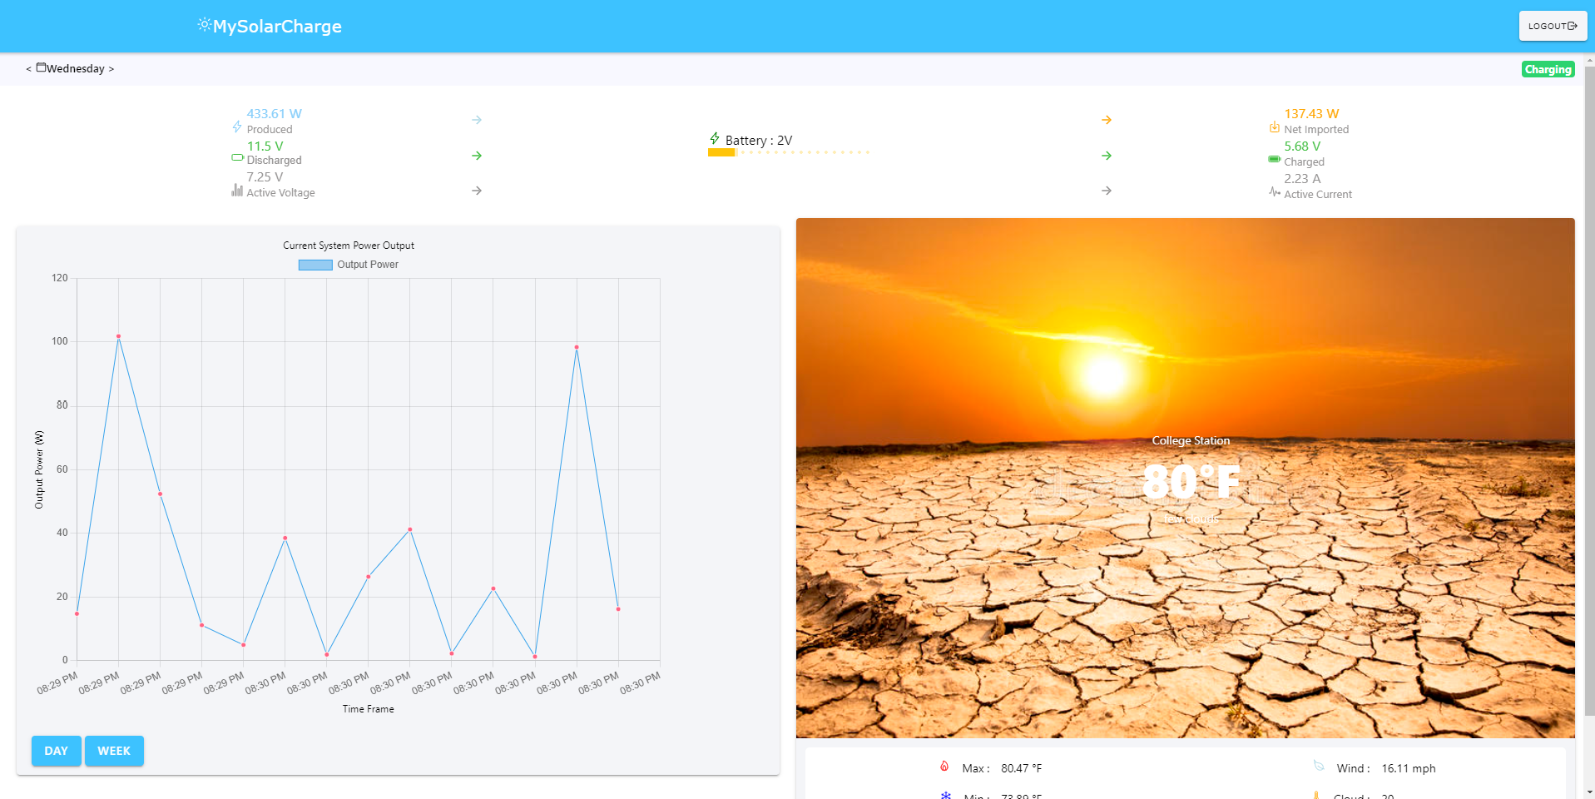
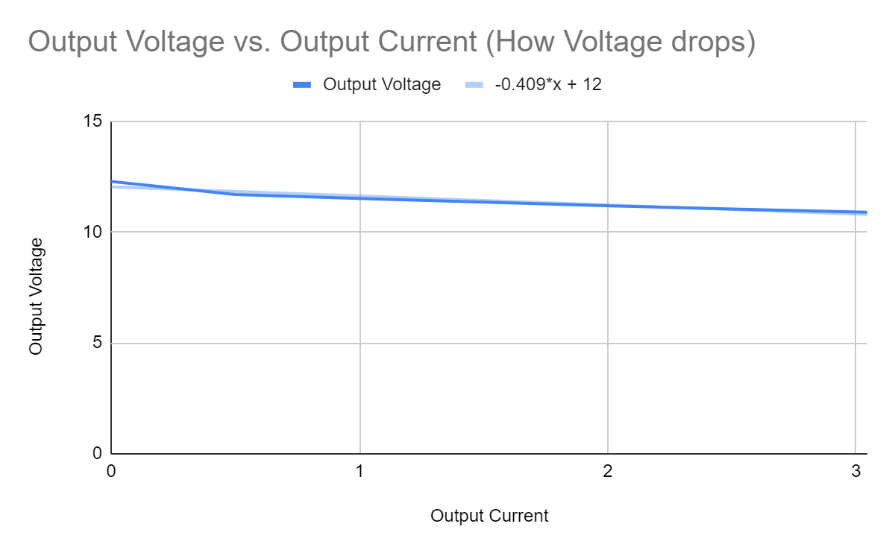
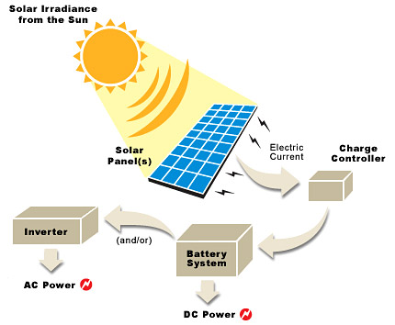
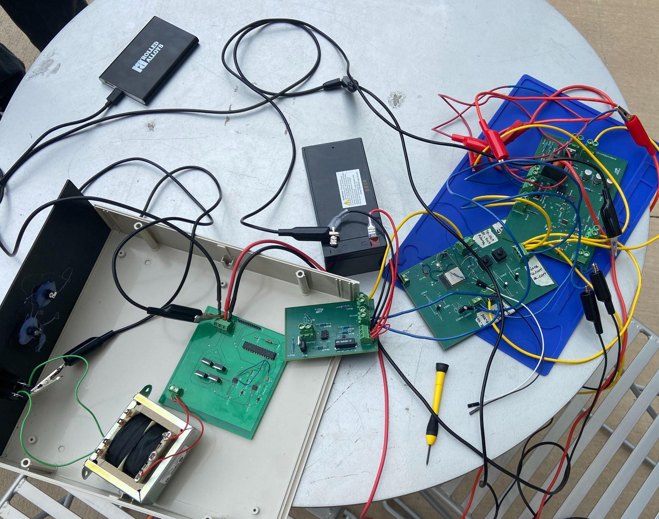
Solar/Power Battery System
Lauren Lugo, Tarik Dawson, Clement Ong, Nathan Gil
Peng-Hao Huang
EPS Booth: Q01
Problem Definition
Rural areas without easy access to power need a way to charge small electronic devices. Our team was tasked to build an independent solar power generating system that can charge both AC and DC devices.
Engineering Analysis
Our system utilizes a microcontroller to self regulate the grid with little to no intervention from the user. This system is unique in that the user can constantly monitor the power output of the solar panel and battery.
We used sensors to send voltage and current values to the computer/phone application
Switches controlled by the microcontroller (ESP32) were triggered to regulate power between the solar panel and battery as needed. Conversion calculations caused some issues with switch control.
Max Power Point tracking regulated the power of the solar panel to the DC-DC Converter for optimal power
System Input vs Output
 | Minimum | Nominal | Max
Solar Voltage | 20V | 55V | 60V
Solar Current | 0A | 0.5A | 1.5A
Output Voltage (DC) | 11.4V | 12V | 12.6V
Output Voltage (AC) | 105.6 | 108.8V | 108.8V
Output Current | 0A | 1A | 3A
website application and android photo
Methodology
Our project is broken down into 4 different subsystems, microcontroller and sensors/switches; DC-DC converter; DC-AC Inverter; and Computer/Phone Application
Microcontroller and Sensors/Switches:
Developed code for Max Power Point Tracking and regulation of sensors/switches
Designed sensors for current and voltage readings
Designed switches to regulate power flow through the system
DC-DC Converter
Designed a DC-DC converter that converts 20-60V Solar DC power into a stable 12V DC power.
Designed to deliver up to 10A for any device up to 120W
DC-AC Inverter
Produced AC output identical to U.S. power grid
Computer/Phone Application
Created a user friendly website and android application that allows system owners to monitor their independent solar system anywhere
Used for maintenance and system analysis providing solar panel and backup battery specifications
Table 2. Power Generation and Usage
The data above shows how the solar panel voltage is converted into its subsequent parts and how power is used when under load.
Outcomes
Our project was able to successfully connected to the solar panel and charge DC and AC devices. Furthermore, the system data was successfully sent to both the android and website applications for monitoring. For our design, we were unable to fully implement the switches, due to the conversion calculations for voltage and current not being accurate.
Impact
The impact of our project goes beyond completing our problem definition. The project should symbolize the accessibility of creating a system that can harness “green” energy for means of an alternative source of power.
Accessibility - With a budget of $400 and spare parts from previous projects, an independent solar panel was created by first time learners.
Versatility: Creating a DC and AC output exemplifies the versatility of harnessing power from the sun.
Environmentally: Powering devices on our solar panel independent system cost nothing to the user, the user’s peers, and the environment.
Figure 2. Output Voltage vs Output current
Tarik
DC-AC Inverter
Solar Panel
DC-DC Converter
Switch
DC Load
Lauren
DAC
Switch
Batteries
MPPT Algorithm (MCU)
Voltage Regulation
Nathan
Computer Application
Phone Application
Figure 3. Functional Block Diagram
Figure 4. System Summary
Control Voltage vs Output Voltage
Control Voltage | 1.2 | 1.0 | 0.8 | 0.6
Input Voltage | 30 | 30 | 30 | 30
Output Voltage | 11.3 | 12.021 | 13.337 | 14.117
Output Current | 1 | 1 | 1 | 1
Due to a fault in the DC-DC converter, we could not validate anything above 3A output, which in turn means we cannot power anything above 36W.
The DC-AC inverter successfully produced a pure sine wave AC output of 107VAC at 60Hz. It was able to power small electronic devices with the conditions given.
References
Welcome to. LearnESP32. (n.d.). Retrieved April 26, 2023, from https://learnesp32.com/
MPPT Charge Controller Reference Design for 12-V, 24-V and 48 ... - Ti.com. https://www.ti.com/lit/ug/tiduej8a/tiduej8a.pdf?ts=1643498144909&ref_url=https%253A%252F%252Fwww.google.com%252F.
Table 1. Control vs Output voltage
Acknowledgements
Peng-Hao Huang, Dalton W. Cyr, Kevin Nowka, John Lusher
Figure 1. Connection to solar panel, charging portable charger

